Slide 1
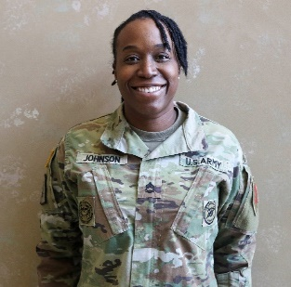
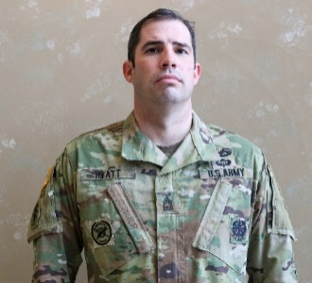
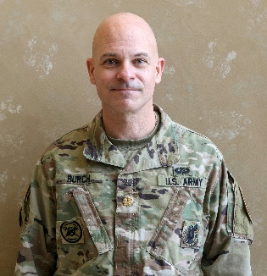
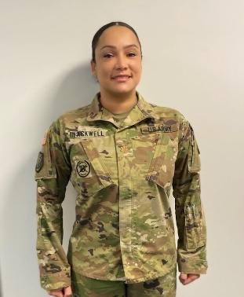
THE
IG UPDATE
Volume 22-2, March 2022
IG Update 22-2: Guidance on Award/Wear of IGIB
Inspectors General (IGs) should use the following guidance as an aid in proper placement and wear of the Army’s newest identification badge, the Inspector General Identification Bade (IGIB).
Award/Wear of IGIB
Temporary wear of the IGIB/IGLP is authorized once an individual has graduated from TIGS (or DOD IG course for Joint IGs), is properly slotted in an IG position, and remains in good standing.
Eligibility for permanent wear is authorized after successful completion of 12 months as an IG or successful completion of an IG tour—curtailment requires an Exception to Policy (ETP). Permanent award of the IGIB and Army Staff Identification Badge (ASIB) cannot be simultaneous; however, once a Soldier qualifies and is awarded the ASIB, their eligibility for permanent wear of IGIB begins.
All former IGs in good standing throughout all COMPOs can wear the IGIB for the remainder of their careers.
No orders are required to add the badge to your individual personnel records.
Uniform Placement of IGIB:
MILPER Message 22-035 and DA PAM 670-1/AR 670-1 provide guidance on placement of the IGIB on Soldiers’ Utility, Service, and Dress Uniforms.
Soldiers will wear the IGIB on the right side for all uniforms; the subdued badge is worn on utility uniforms, with the badge centered on the right breast pocket between the bottom of the pocket flap and the bottom of the pocket (See photo in the right column).
However, Soldiers may move the lower precedence badge to the left side of the ACU [OCP] coat.* (same placement as previously noted/left breast pocket, between bottom of pocket flap and bottom of pocket.
IGIB comes after the Instructor Identification badge in order of precedence.
Soldiers remain limited to a total of two badges on the ACUs [OCPs], one per side.
Current IGs are not authorized to wear the IGIB on service or dress uniforms, while non-active (previous IGs) may do so.
For DA photos, Soldiers should wear their branch crest, and those who’ve met permanent wear eligibility can also wear the color version of IGIB (when available).
Department of the Army Inspector General
The Inspector General
LTG Donna W. Martin
Deputy, The Inspector General
MG Mitchell L. Kilgo
The Inspector General Sergeant Major
SGM Larry H. Orvis
SFC Johnson wears IGIB on left,
Drill Sergeant Badge on right
References
DA PAM 670-1/AR 670-1 (Guide to the Wear and Appearance of Army Uniforms and Insignia).
ALARACT 091/2021 (Implementation Guidance Inspector General Identification Badge/Inspector General Lapel Pin.
MILPER Message 22-035 (Establishment of the Inspector General Identification Badge).
MSG Hyatt wears IGIB on right,
Master Gunner badge on left
Purchasing
Each military graduate of TIGS will receive one subdued IGIB, and each Civilian graduate will receive one IGLP.
All IGIB and IGLP items should be available at your local AAFES Clothing Sales by Spring 2022.
Major Burch wears IGIB on right ,
Recruiting Badge on left
ETP requests
Send all requests (including a memo from requestor/supporting documentation) to The Inspector General Sergeant Major, SGM Larry Orvis at larry.h.orvis2.mil@army.mil.
Major Blackwell wears IGIB on right

